Slide 1
Lecture # 1
Professionalism
http://www.flickr.com/photos/wili/242259195/

Slide 2
Course Outline
What is Professionalism
Characteristics of perfoessionalism
Traits of a professional
Moral laws and Ethics
IEEE code of Ethics
Some scenarios to contemplate

Slide 3
Professionalism takes more than knowledge
“Professionalism is a way of thinking and living rather than an accumulation of learning.”
Think: What does it take to be a doctor?
  it’s not just by going to medical school

Slide 4
Profession
A profession isn’t just what you do, it’s who you are

Slide 5
A profession is who you are, not a contract.
“Shame on the engineer who regards their professional function as a business transaction to be judged by the question: ‘Just what do I get out of it?’”

Slide 6
Life as a professional: activities
You perform “professional activity of a type carrying high individual responsibility, requiring application of special skills to activities that are predominantly intellectual and varied rather than routine and normal.”

Slide 7
Life as a professional: motivation
“Motivation for service takes first place over consideration of reward.”

Slide 8
Life as a professional: joy and pride
“Motivation … implies joy and pride in the work to be done, and self-imposed standards.”
If you don’t take joy and pride in computer science, then you should look for another line of work.
Companies and customers are also entitled to impose (secondary) standards of excellence.

Slide 9
Life as a professional: social duty
You have a “social duty, fulfilled through guarding the ideals and standards of the profession, by advancing it …, by sharing advances …, by rendering gratuitous public service, all as a return to society.”
“Giving back” to society

Slide 10
Four traits of a professional
Varied activities requiring special skills
Society-centric motivation
Personal standards of excellence
Giving back to society

Slide 11
When you put many professionals together, what do you have?
A profession isn’t just defined by who you are
A profession is also something you are part of
“Most professional software engineers adopt an institutional view of the organizations of the profession: they perceive them as bodies representing the profession and therefore deserving, even requiring, the loyalty of each software engineer as an expression of his identity as a professional software engineer.”

Slide 12
Part of being a professional is behaving ethically
“Ethics means something more than ‘law’ and ‘morals’; it carries an additional connotation of ‘rightness’.”
Breaking the law: can earn a fine or jail time
Breaking a moral: can ruin your reputation
Breaking an ethic: can ruin your conscience
It’s possible to break all three, simultaneously!

Slide 13
The Difference Between Morals, Ethics, and Laws
Morals: one’s personal beliefs about right and wrong
Ethics: standards or codes of behavior expected of an individual by a group(nation, organization, profession).
Law: system of rules that tells us what we can and cannot do
  Laws are enforced by a set of institutions
  Legal acts conform to the law
  Moral acts conform to what an individual believes is the right belief of right and wrong.

Slide 14
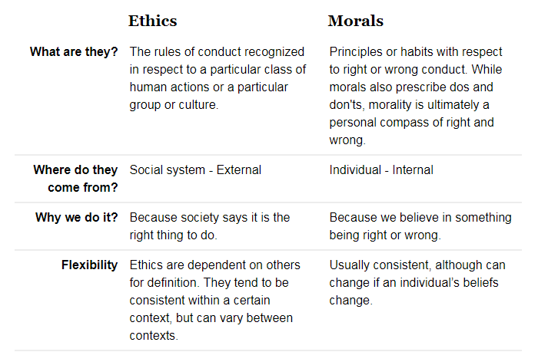
Comparison

Slide 15
Trait # 1 of a professional: Seriousness
Serious about job.
The job is only a job.

Slide 16
Trait # 2 of a professional: Wanting to do Better
Exhibit a never-ending improvement in your performance in every variable, every project, every relationship, and every detail.

Slide 17
Trait # 3 of a professional: Dealing with the Unexpected
Stuff happens, things change, and the true professional rises to the occasion

Slide 18
Trait # 4 of a professional: Communication Skills
Clear
Concise
Confident

Slide 19
Trait # 5 of a professional: Enthusiasm
Attitude is everything. Those who exhibit enthusiasm for what they do and greet each day with a positive attitude inevitably become a leader

Slide 20
Trait # 6 of a professional: Helpfulness
Understand that real success in the workplace requires teamwork
Always ready to help others
Make a suggestion
Offer a compliment when it’s deserved

Slide 21
Trait # 7 of a professional: Taking the Initiative
Take the initiative to get things done

Slide 22
Trait # 8 of a professional: Cool Under Pressure
Level headed and calm
Cheerful demeanor-even under stressful times

Slide 23
Trait # 9 of a professional: Remains Focused
Stay focused on the task at hand and the goal ahead
Navigate through obstacles or setbacks but never lose sight of where they headed

Slide 24
Trait # 10 of a professional: Don’t Follow, Lead
True Professionals aren’t faint of heart
Analyze the situation and willing to take new paths and try new solutions
That’s why they call it LEADERSHIP!

Slide 25
Laws vs morals vs ethics
Speeding within city
  Illegal, immoral, unethical
What might a software engineer do that is…
  Illegal, immoral, unethical ?
  Legal, immoral, unethical ?
  Legal, moral, unethical ?

Slide 26
IEEE Code of Ethics: Actions
1. PUBLIC - Software engineers shall act consistently with the public interest.
2. CLIENT AND EMPLOYER - Software engineers shall act in a manner that is in the best interests of their client and employer consistent with the public interest.

Slide 27
IEEE Code of Ethics: Products
3. PRODUCT - Software engineers shall ensure that their products and related modifications meet the highest professional standards possible.

Slide 28
IEEE Code of Ethics: Hierarchy
4. JUDGMENT - Software engineers shall maintain integrity and independence in their professional judgment.
5. MANAGEMENT - Software engineering managers and leaders shall subscribe to and promote an ethical approach to the management of software development and maintenance.

Slide 29
IEEE Code of Ethics: Peers
6. PROFESSION - Software engineers shall advance the integrity and reputation of the profession consistent with the public interest.
7. COLLEAGUES - Software engineers shall be fair to and supportive of their colleagues.

Slide 30
IEEE Code of Ethics: Self
8. SELF - Software engineers shall participate in lifelong learning regarding the practice of their profession and shall promote an ethical approach to the practice of the profession.

Slide 31
8 Principles of IEEE Code of Ethics
Act in public interest
Act in interest of clients and employers
Produce quality products
Maintain independent judgment
Manage ethically
Protect integrity of profession
Support colleagues
Pursue lifelong learning

Slide 32
Scenario #1
You are the owner of a software engineering company. Your employees (engineers) want you to pay for them to attend training.
How would you respond in a way that is
legal, moral, and ethical?

Slide 33
Scenario #2
You are the owner of a software engineering company. Your employees (engineers) want you to let them do pro bono work for a local non-profit organization on company time.
How would you respond in a way that is
legal, moral, and ethical?

Slide 34
Scenario # 3
You are a software engineer working at a large publicly-traded corporation, where a colleague invents a new kind of compiler. Your managers see it as a huge potential cash cow.
How would you respond in a way that is
legal, moral, and ethical?

Slide 35
Scenario #4
You are a software engineer at a company where management routinely encourages you and your colleagues to use pirated software.
How would you respond in a way that is
legal, moral, and ethical?

Slide 36
Summary
Professionalism
Activities and Tasks carried out by a professional
Traits of a good professional
IEEE code of Ethics
Scenarios to think about

